Slide 1
wqd7005
File created on: 5/2/2019 1:14:20 AM

Slide 2
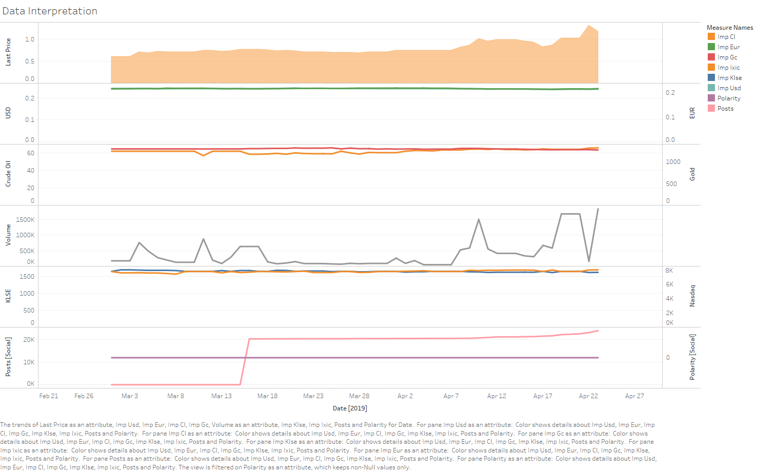

Slide 3
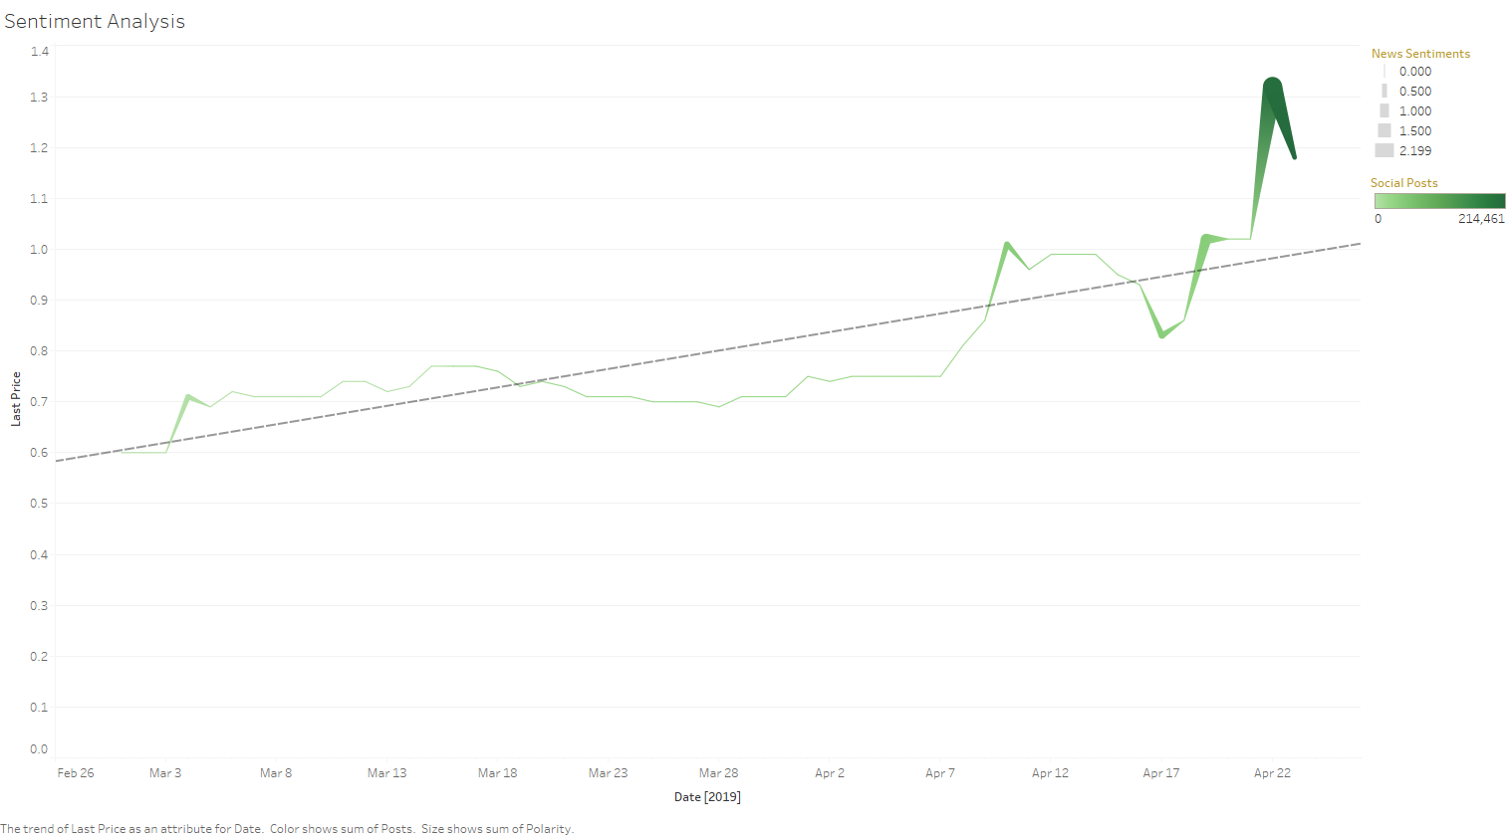

Slide 4
